Slide 1
The open prison project
Owen Brake

Slide 2
What is an Open Prison?
A prison where the inhabitants live:
Peacefully
Humanely
Inhabitants possess the keys to their own buildings
There is minimal supervision and inmates have more control over there lives
There is little to no border security

Slide 3
Purpose
To rehabilitate long term offenders
5 years or more sentence
Inmates have been held for much of their life
May not recognize the society that exists now
What would it be like if someone from the past came to the present
5 years ago?(2012)
10 years ago?(2007)
20 years ago?(1997)
Could they get a job?
Technology
Social Norms
To hold people humanely
"You see them standing over there at the end of the car park watching the sun go down over the fields. They stand there for ages. They've been locked up for so long that they've forgotten what a sunset looks like.“(James, 2011)
Notes:
James, E. (2011, January 13). Why life in an open prison is no holiday camp. Retrieved December 07, 2017, from https://www.theguardian.com/society/2011/jan/13/open-prison-no-holiday-camp

Slide 4
History
Popular in Scandinavia
Developed in the late 20th century
In response to rising incarceration rates
Process called decarceration
Decarceration
Leads to no increase in crime
Prisoners better prepared for society

Slide 5
Segregation of Prisoners
There is segregation of prisoners only in private matters
Sleeping, Changing, Washroom
Segregation by Gender
Possibility for segregation of prisoners upon request
Safety concerns
No segregation based on sentence
Murderers will live with drug dealers
All prisoners have an initial sentence of a minimum of 5 years
No reason for segregation
Those who offend in prison will return from where they came

Slide 6
Dealing with unsavoury behaviour
Any sort of criminal offence that exists outside of the prison applies inside
For small offences like
Alcohol and drug possession
3 strikes then back to closed prisons
For large offences like
Rape, Assault, Murder, threats
Immediate return to closed prison with potential for increased sentences

Slide 7
Prison Guards
Will be armed with light firearms
Small patrols around the campus
Guards take shifts in the public buildings
Guards are expected to treat prisoners as civilians
Searches will be done only with probable cause
Entering a dorm requires explicit permission from the warden
Main purpose of the guards is to protect the prisoners not harm them

Slide 8
Employment
Prisoners will be able to work for the prison
Prisoners receive salary
Learn responsibility
Gain skills on the job
See the benefit the labor does and the effect it has on their community
Cleaning
Working in the rec building
Maintenance
Prisoners will be able to apply to work outside of the prison
Prisoners receive salary
Gain workplace experience
Very important since the employer can see they have a criminal record
Learn the skills they need for future jobs

Slide 9
Purposes of Sentencing
In an Open Prison

Slide 10
Rehabilitation
Inmates get to experience what a normal life is like and learning how to manage these tasks.
Inmates will learn to become more responsible
Inmates will learn what has changed in society
Technology
Social Norms
Events
Those who go through the open prison system experience a 20% drop in recidivism rates.

Slide 11
Denunciation
Prison houses long term offenders
Most likely have realized their mistake and regret them, their only issue is preventing a repeat of the behaviour
This is not a holiday camp
These people may appear to live good lives but they lack
Liberty
Freedom of mobility
Cannot see their families
Choice
These things seem disposable to us, but are fundamental to the human psyche

Slide 12
Protection
Trust System
Inmates will understand the benefits of living in this prison
If there is any major offences, they will be sent back to an institution
If a prisoner leaves the property when they are not supposed to then they will be sent back to where they came

Slide 13
Dormitory
In an Open Prison

Slide 14
Bedroom
Two to Three bedrooms per Dorm
Two beds per bedroom
Each person has a roommate
Shared responsibility, they both rely on each other to maintain the room
Open space in bedroom, room for amenities
Bookshelf
Desks
Posters

Slide 15
Kitchen/Dining Room/Open Space
Inmates are responsible for much of their personal life
Cooking
Cleaning
Washing
The open space allows the inmates to socialize and bond
Dorm looks and functions just like a normal house

Slide 16
Recreation Room
In an Open Prison

Slide 17
Main room
Ping pong tables
Foosball tables
Pool
Darts
General Tables
Purpose
Socialization
Discuss what they did wrong
Entertainment

Slide 18
Bathroom/Showers
Self-explanatory
Segregated based on gender
Closed stalls

Slide 19
Workout Room
Maintain physical health and fitness
Healthy body -> healthy mind
Socialize
Create employment opportunities for inmates
Fitness Trainers
Kinesiology

Slide 20
School
In an Open Prison

Slide 21
In Class
Receive up to high school degree
Taught many courses
Get taught with peers
Employment training
Trades
Basic Skills training
Technology
Etiquette
How to get a job
Employs outside educators and inmates
Inmates with education certifications or experience can teach courses
Inmates with certain experience as employers or employees can teach trades or skills

Slide 22
Out of Prison
Possibility to apply to post secondary schools
Get the education requirements for high paying professions
Possibility to apply to apprenticeship
Get the experience and certification for trades
Out of prison, get to interact with other people
Gain connections in companies
Become reintegrated in society

Slide 23
Benefits
Of an Open Prison

Slide 24
Humanitarian
Closed prisons are hell on earth
Many people do see the sun for more than 1 hour a day
Can be extremely mentally traumatizing
Socialization is stripped from you
Very small contact between people
Can cause mental health issues

Slide 25
Cost-Effective
Security Measures
No border fence
No guard towers
No armored doors
Employees
Inmates will be responsible for much of the work done
Cleaning
Cooking
Education
Maintenance
Low Recidivism Rate
Low recidivism = less prisoners = less capacity required in the long run

Slide 26
More effective than closed prisons at Rehabilitation
Lower recidivism rates
Provides unique Education and Employment opportunities
Encourages socialization so that

Slide 27
Location
Of the Open Prison

Slide 28
Outside Kingston, Ontario
Near larger rural towns(Alternatives)
Waterloo
Kingston
Has Queen’s university
Provides employment opportunities
~1% lower unemployment than national average
Kitchener
Near towns to encourage integration of prisoners into community while minimizing the possibility of a prisoner escaping
In rural area
Prevent escape
Landscapes and nature can be very soothing for prisoners
Isolated area allows large quantity of land to be manipulated

Slide 29
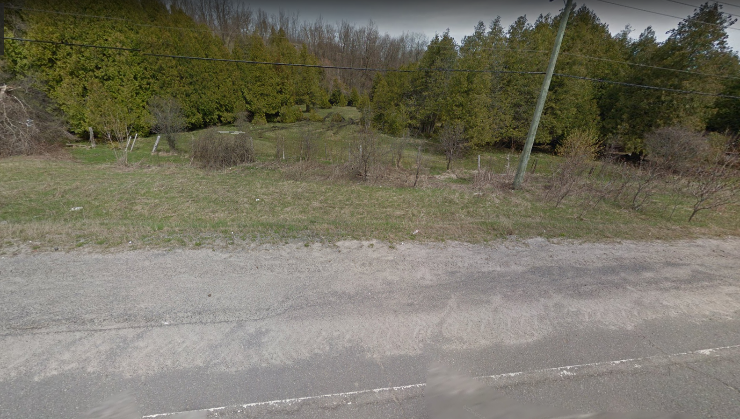

Slide 30
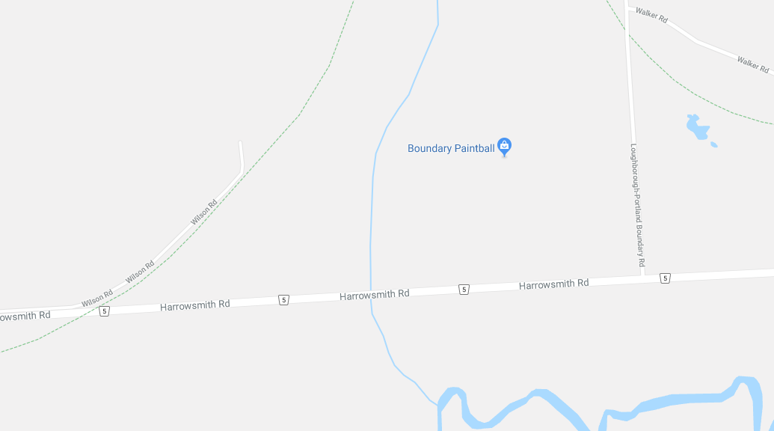

Slide 31
Thank You
Questions?

